Slide 1

Pre Physical App
Jan 2026

Slide 2
Pre-Physical:
Current process:
Manual validations
Navigating through multiple systems
Human dependent validation
Complex and changeable process (per configuration)
Manual report
Purpose:
One System -> Maximum Automation
Run software checks automatically.
Run hardware checks automatically.
Organized tracking to the pre physical process

Slide 3
Mission:
Mission:
Run software checks automatically.
Automatic hardware list and notifications.
Automatic baselines list.
Automatic report.
Organized tracking to the pre physical process.

Slide 4
Phases
Pre Physical – software, hardware, basic baseline list, report
Full baseline report + ACC list integration
Full automation for 3 steps
Integration with parallel systems

Slide 5
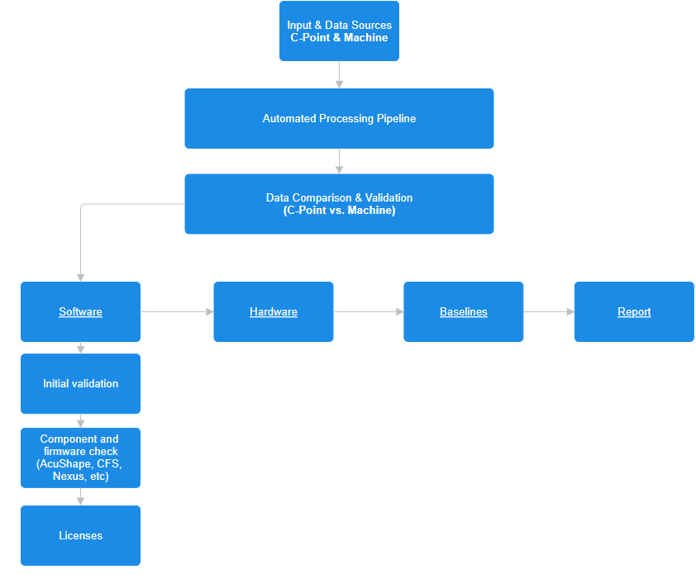
Flowchart

Slide 6
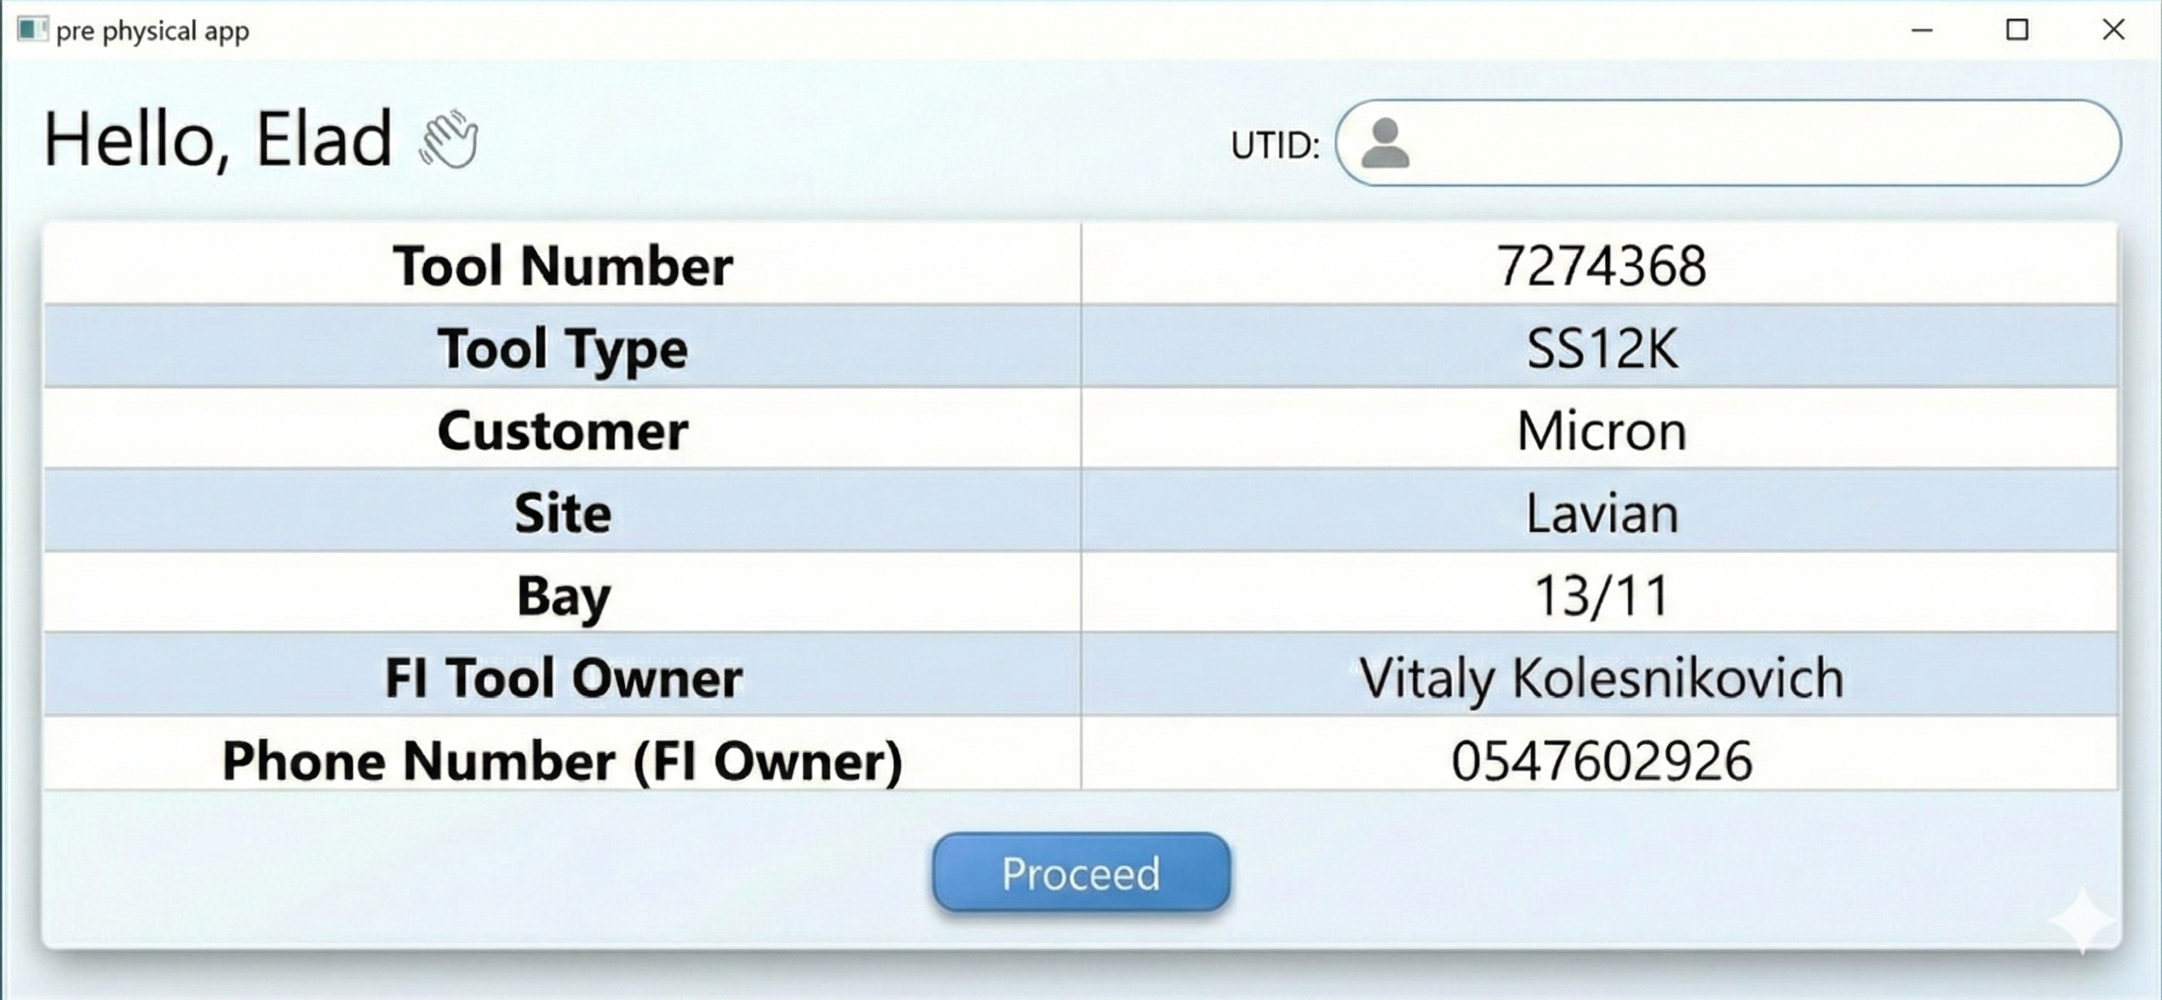
Opening Screen:

Slide 8
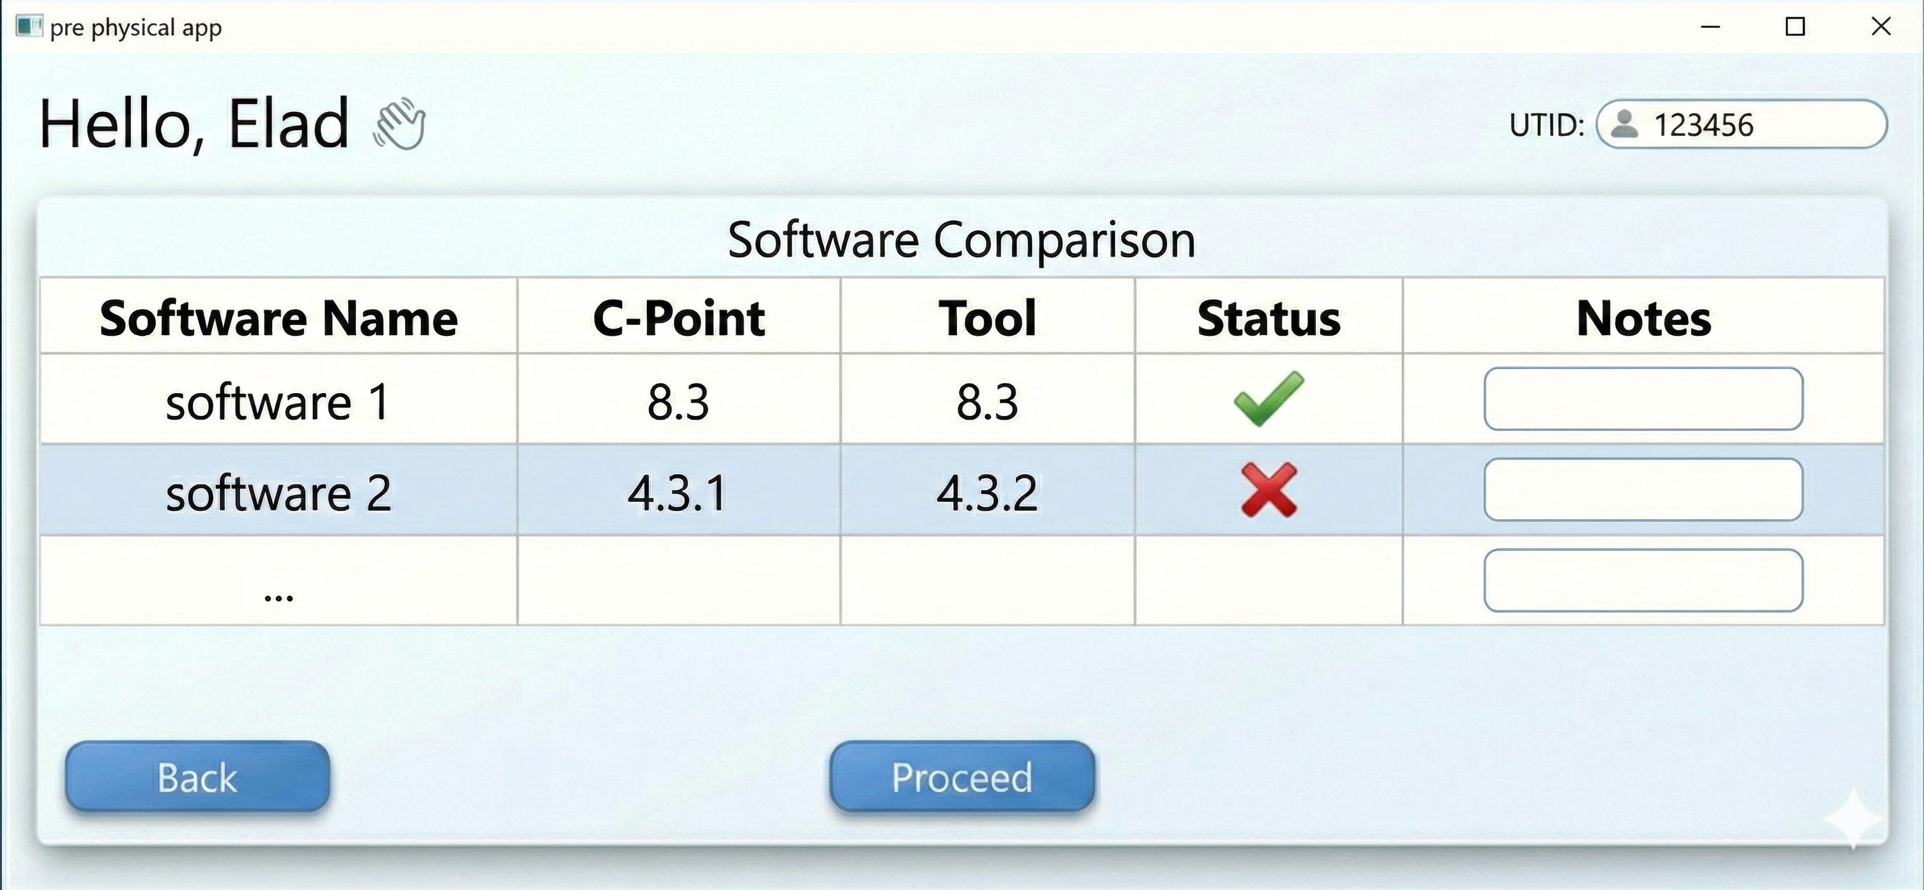
Software Screen:

Slide 9
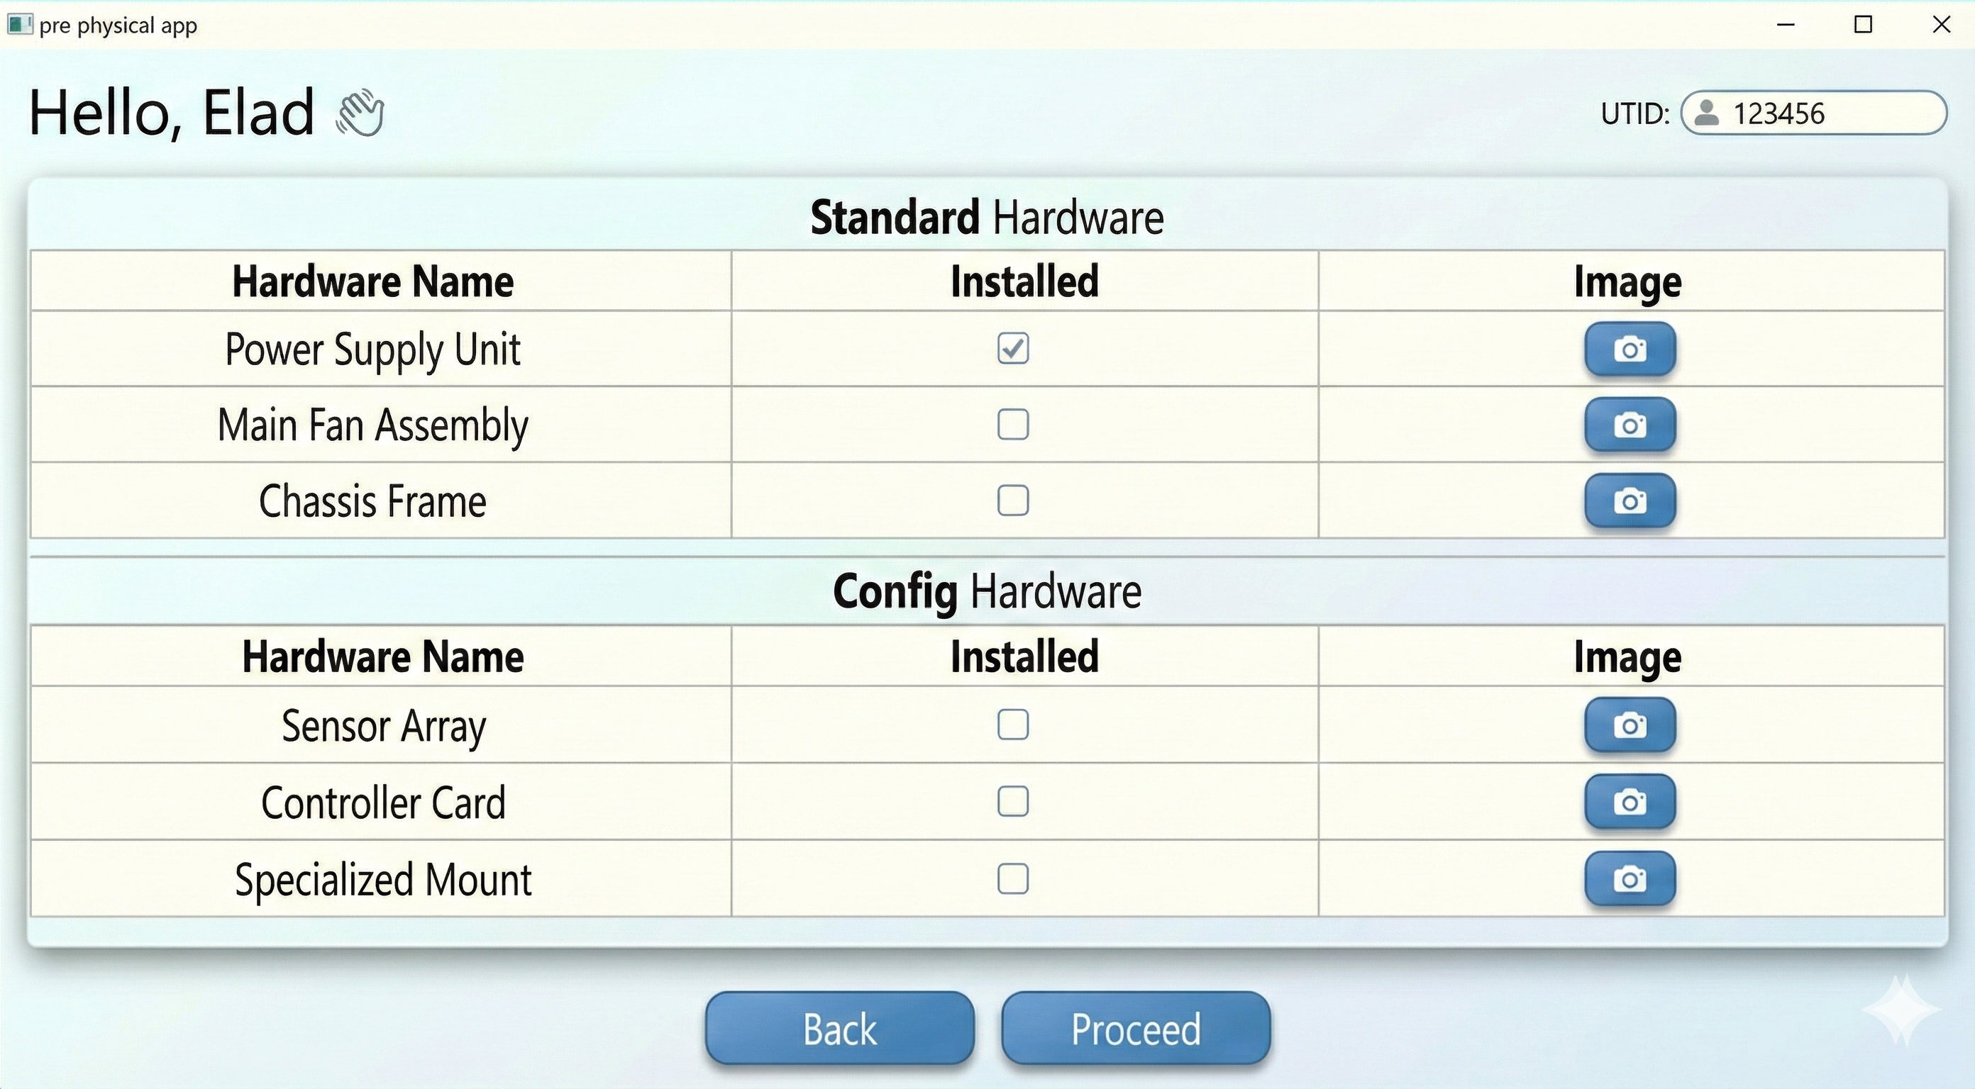
Hardware screen:

Slide 10
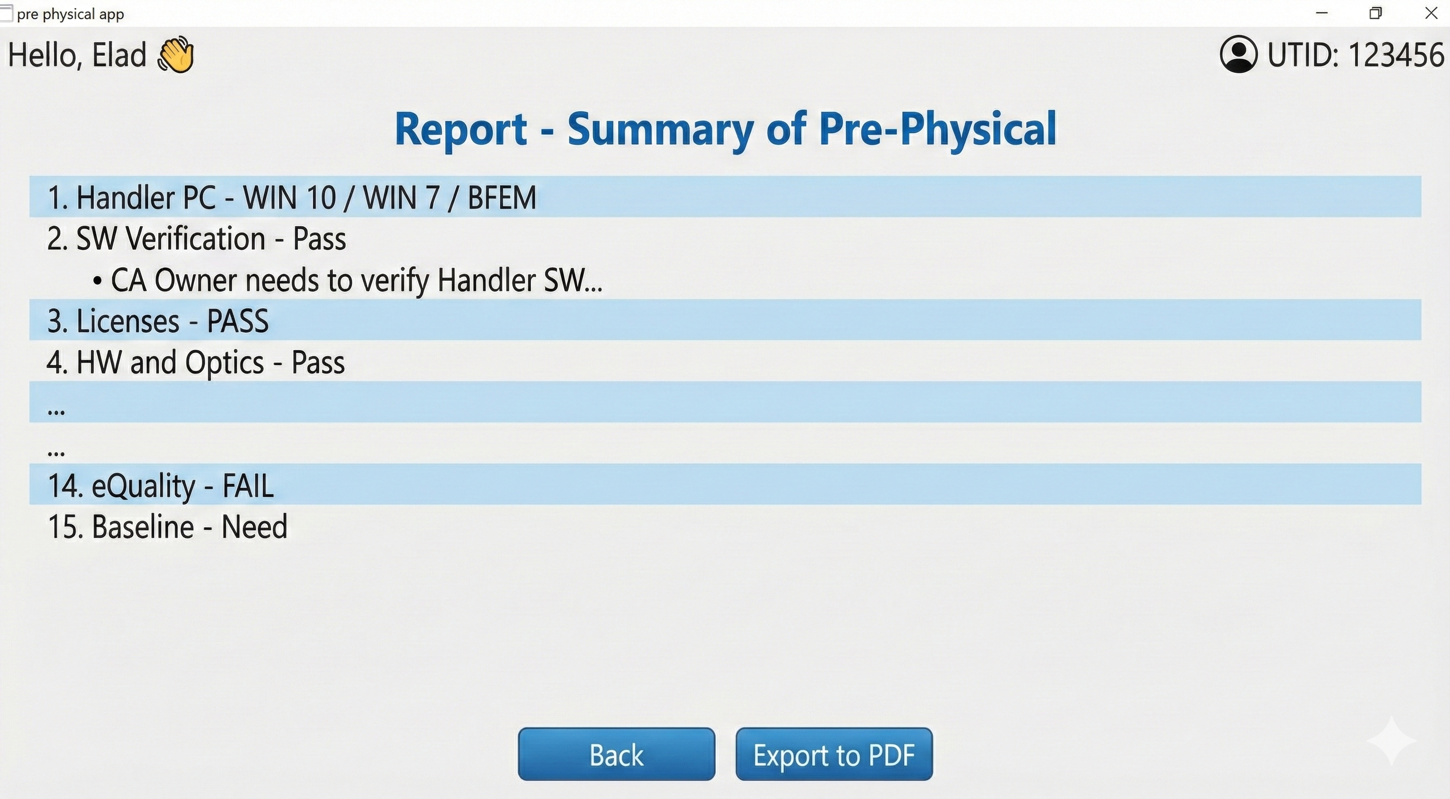
Final Report:

